Slide 1
Hr analysis report PRDA-03 Findings ,insights & recommendations
Submitted by:ptid-cda-feb-25-371

Slide 2
Objectives of analysis
THE PRIMARY GOALS OF HR ANALYTICS: E
Analyze Employee Demographics
Uncover key workforce trends,diversity metrics,& hiring patterns
Understand Department wise Employee Distribution
Generate Insights for HR Decision-making
Recommendations to improve talent,aquistion,retention,& overall workforce management

Slide 3
Data overview
KEY ATTRIBUTES OF DATASET:
Employee ID
Names(First and last)
Age
Gender
Race
Department
Location&State
Hire Date
Term Date
DATASET:
22,214 records
13 columns
TOOLS USED:
SQL(Data extracted from sql)
POWER BI

Slide 4
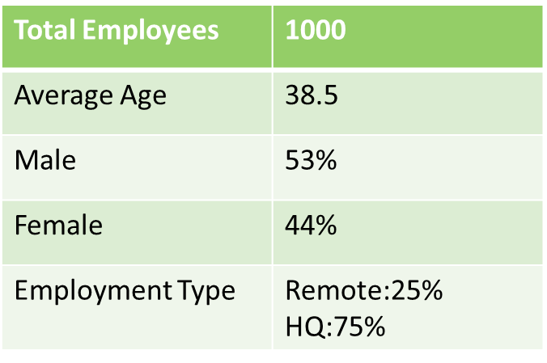
KPI Analysis
INSIGHTS:
25% EMPLOYEES WORK REMOTELY WHILE 75% ARE IN HQ
Workforce growth is steady,but certain departments need strategic workforce planning
Remote work trends impact engagement
Less female percentage engagement is reflecting gender diversity
Experiential diversity might reflect in the strategies of company including
HR
Hr must improve engagement strategies to reduce the retention rate

Slide 5
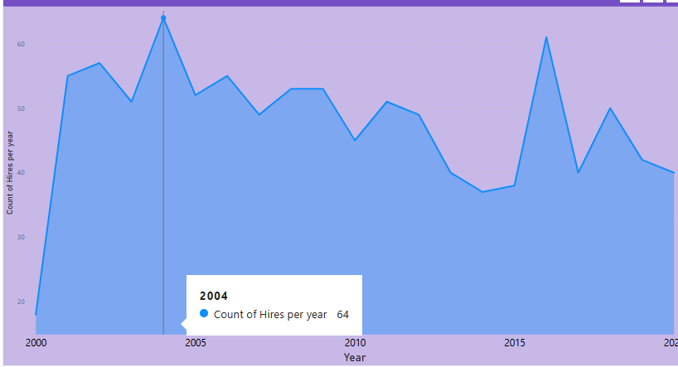
HIRING TREND
OVERALL HIRING TRENDS:
Total new hires in 2020: 40 hires
Peak hiring occurred in 2004: 64 hires
Hiring slowed in: year 2000 possibly due to initial period of strategies and implementations
Department wise hiring:
Highest recruitment in Engineering department with 23 of total hires
Lowest hiring in Auditing and business development department with 1 of total hires possibly due to less opportunites or salary concessions

Slide 6
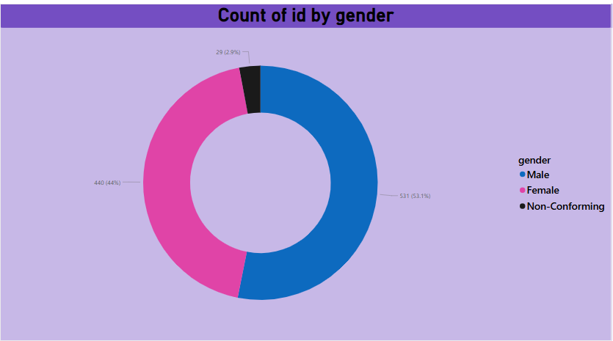
Gender diversity
Male representation: 53% of workforce
Female representation: 44% of employees
Non confirming: 3% of employees
The gender gap in leadership position is evident,with 53% male leaders compared to 44% female leaders
Some departments may have lower female representation,indicating a need for diversity-focused hiring.

Slide 7
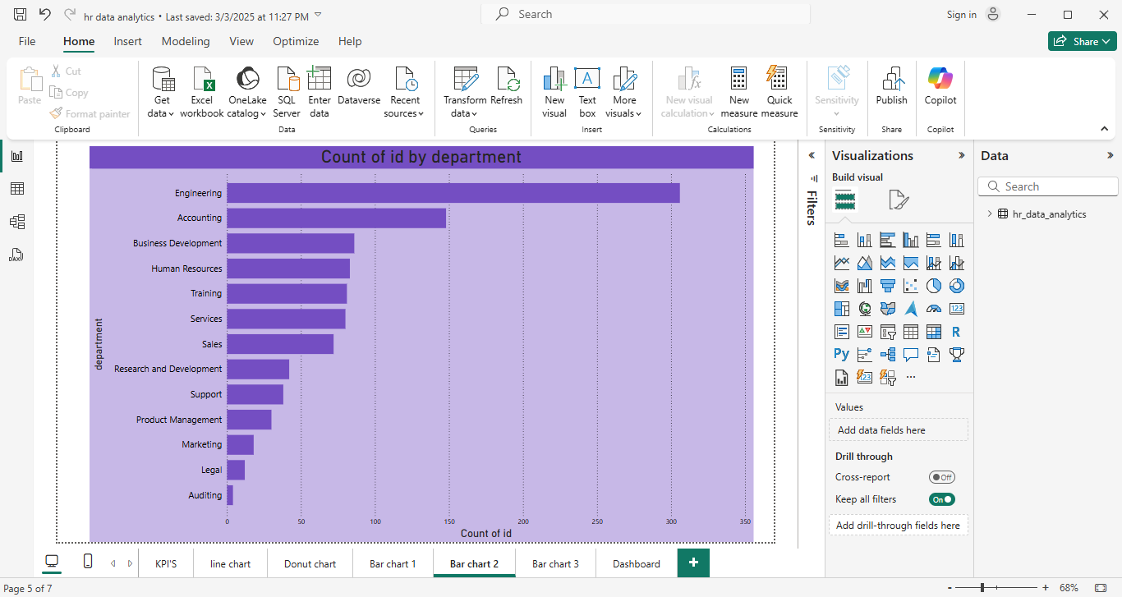
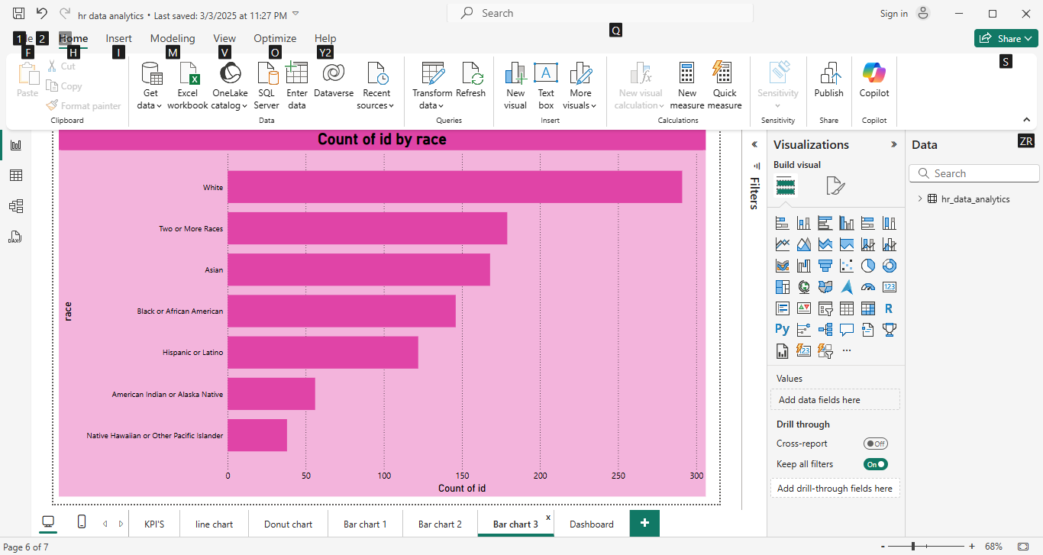
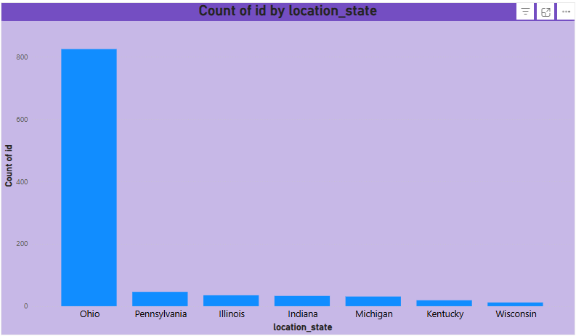
Employee distribution
Total Employees: 1000
Employees by location/state: Represented in Clustered column chart
Employees by Department: Represented in Bar chart
Employees by race: Represented in Bar chart

Slide 8
DASHBOARD OVERVIEW
Power BI Dashboard includes:
Employee Demographics Analysis
Hiring Trends
Department wise workforce insights

Slide 9
KEY Insights
The workforce is unevenly distributed across departments and locations. Some teams are overstaffed, while others have workforce shortages
Some departments have higher hiring rates, while others struggle to attract talent.Hiring peaked in specific years while some years did not work out
Gender imbalance exists in leadership roles, with men occupying a higher percentage
Employee attractions toward HQ working should be increased for better on field involvement
Remote working employees percentage over power the HQ percentage
The Employee percentage based on race seems to be reflectiong HR in negative light(e.g race discrimination)

Slide 10
Strategic Recommendations
Strengthen hiring and workforce planning to align with business needs
Improve employee engagement & career development to reduce attrition
Ensure fair compensation and benefits to enhance job satisfaction.
A special session should be conducted for HR’s based employee analysis which will simultaneously impact hiring quality
Promote diversity in leadership
Optimize remote work policies for better productivity.

Slide 11
CONCLUSION
Every Recommendation should be considered to get to the actual solution. Conduct an employee survey to understand challenged.HR analytics provides valuable insights to drive better decision-making, workforce efficiency, and employee satisfaction. By implementing these recommendations, the company can create a more inclusive, engaged, and high-performing workforce.

Slide 12
THANK YOU

